Slide 1
Clothes Store Analysis

Slide 2
Agenda
Introduction
ETL Process
Data Warehouse (DWH) Design
SQL Queries and Analysis
Power BI Visualization
Key Insights

Slide 3
Introduction
Project Overview
The Clothes Store Analysis project aims to provide a comprehensive understanding of our store's performance through data-driven insights. By leveraging ETL processes, SQL, and Power BI, we analyze key metrics and trends to enhance decision-making and drive business growth.

Slide 4
ETL Process
ETL Using SSIS
Extraction: Used SSIS to pull data from Excel files.
Transformation: Cleaned, standardized, and enriched data.
Loading: Loaded data into SQL Server and indexed it.

Slide 5
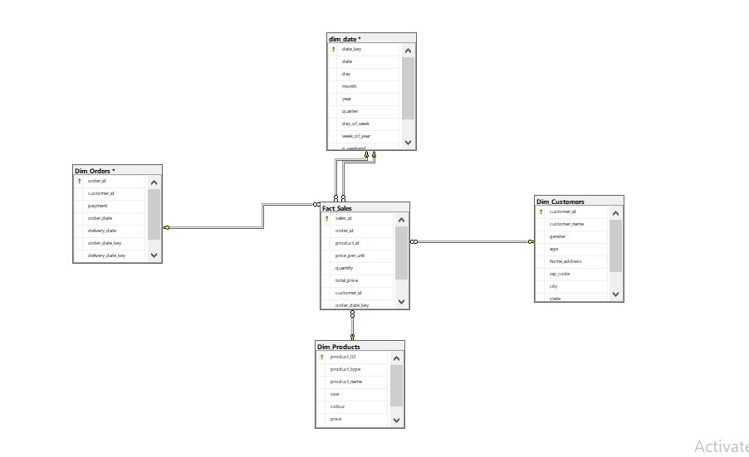
Data Warehouse (DWH) Design

Slide 6
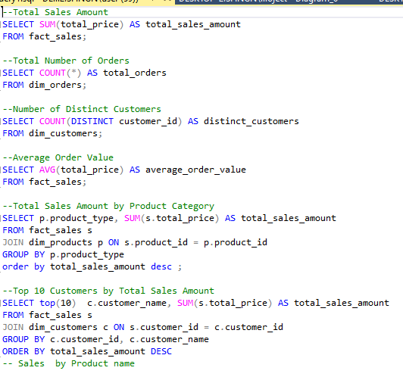
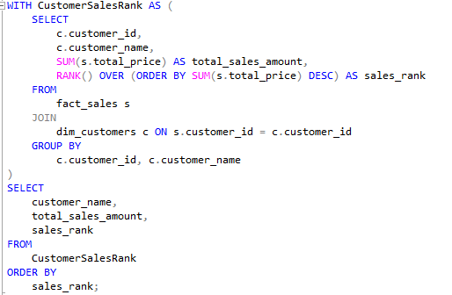
SQL Queries and Analysis

Slide 7
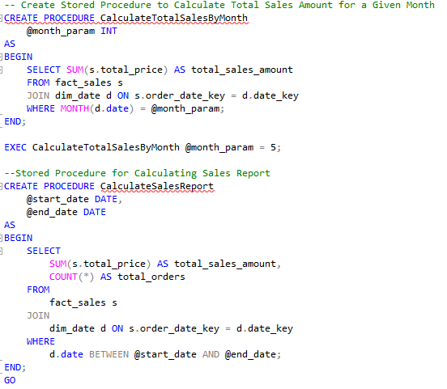
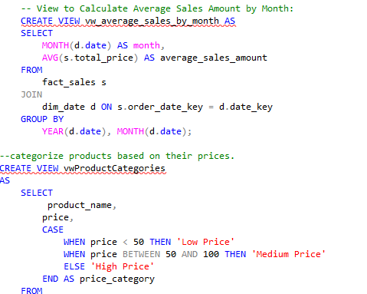
Views and Stored Procedures

Slide 8
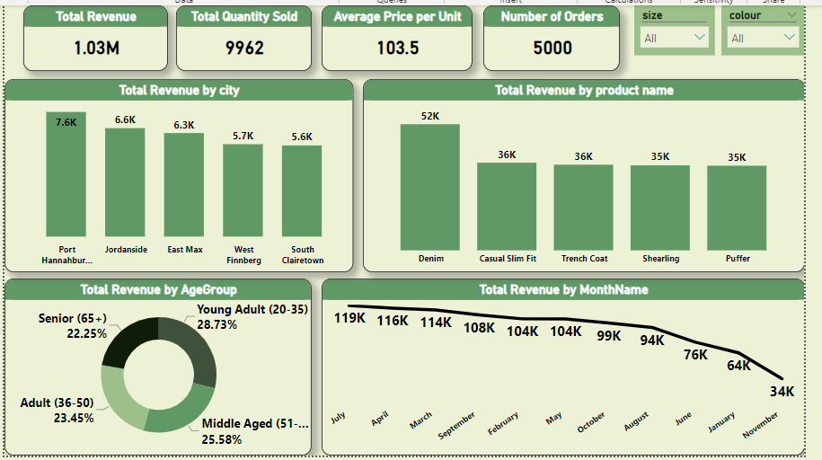
Visualization-Page 1

Slide 9
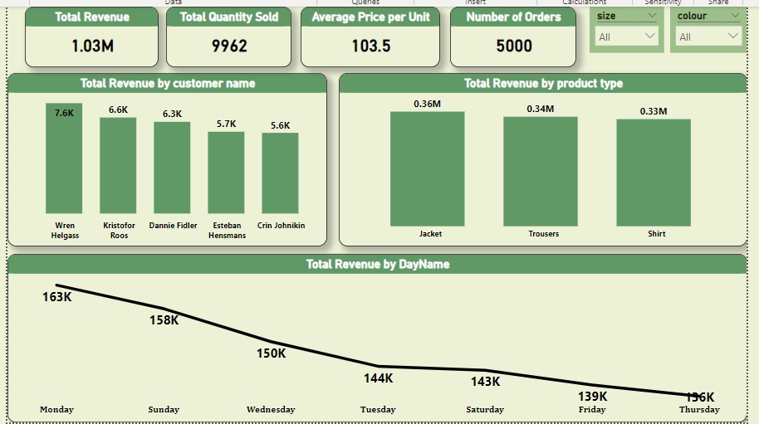
Visualization-Page 2

Slide 10
Key Insights
Dashboard Overview
Age Group Analysis by Total Revenue
Visual representation of revenue generated from different age groups.
Insight into which age groups contribute the most to overall revenue.
Sales Trends per Month Name and Day Name
Monthly and daily sales trends visualized to identify patterns.
Helps in understanding peak sales periods and customer behavior over time.
Total Revenue per City
Geographical representation showing revenue distribution across cities.
Enables targeted marketing and resource allocation based on city performance.
Top Customers by Revenue
List of top customers ranked by their contribution to revenue.
Facilitates personalized customer engagement and loyalty programs.

Slide 11
Thank you
Amr Azzam
01022900545
amrazzam1998@gmail.com
https://www.linkedin.com/in/amrazzam10/

